Slide 1




EfficientSAM:
Leveraged Masked Image Pretraining for Efficient Segment Anything
- META AI Research
2024 IEEE/CVF Conference on Computer Vision and Pattern Recognition (CVPR)
Instructor:
Prof. C.K. Mohan
Teaching Assistant:
K R Anuraj
Presenter:
Isha Kumar

Slide 2


Agenda Overview
01
Motivation
06
Experiments and Results
02
Problem Statement
07
Limitations of the Proposed Method
03
Challenges
08
Future Work
04
Related work with Limitations
09
Conclusion
05
10
References
Paper Methodology

Slide 3

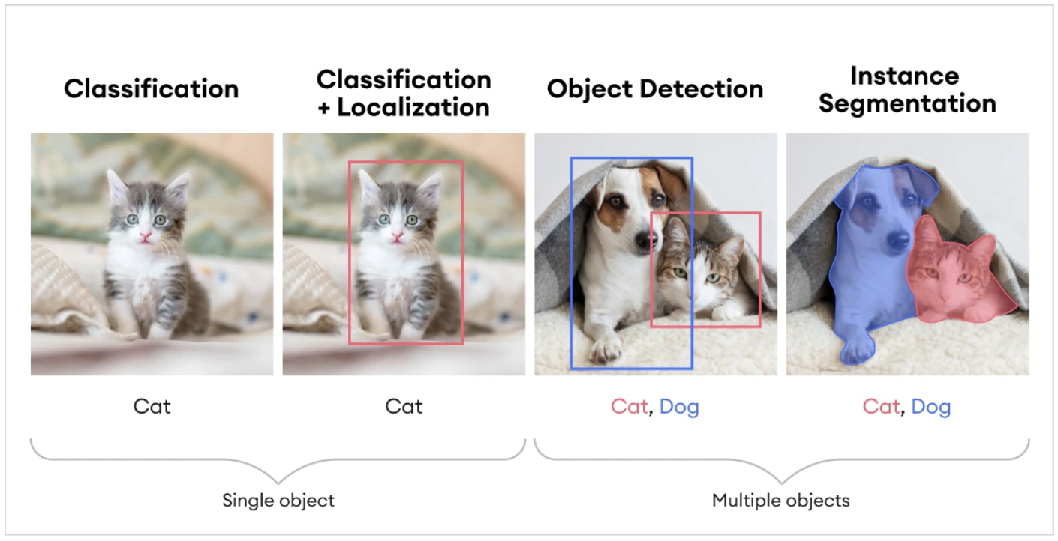
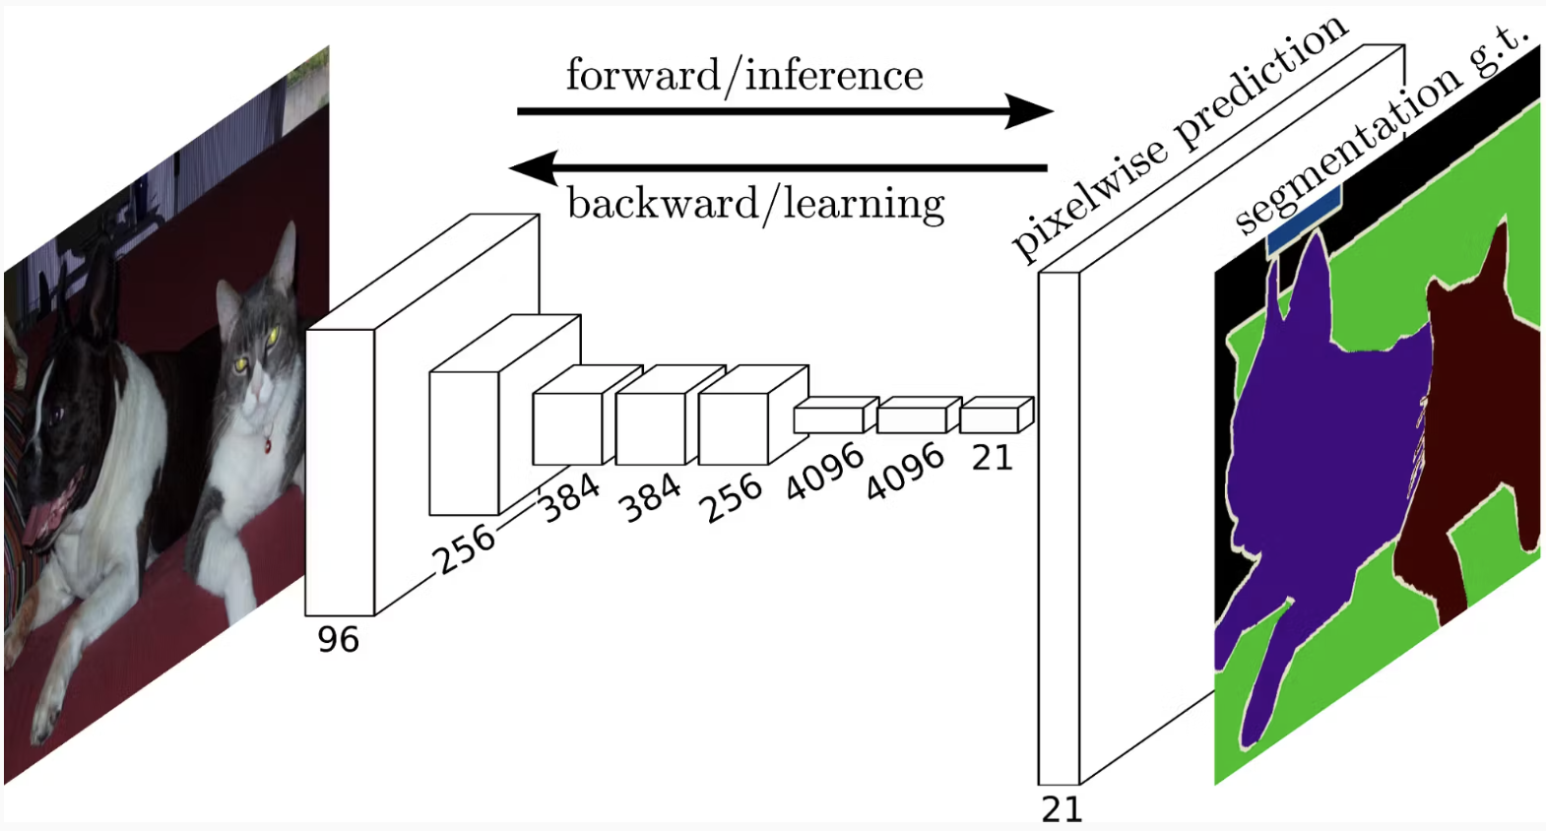
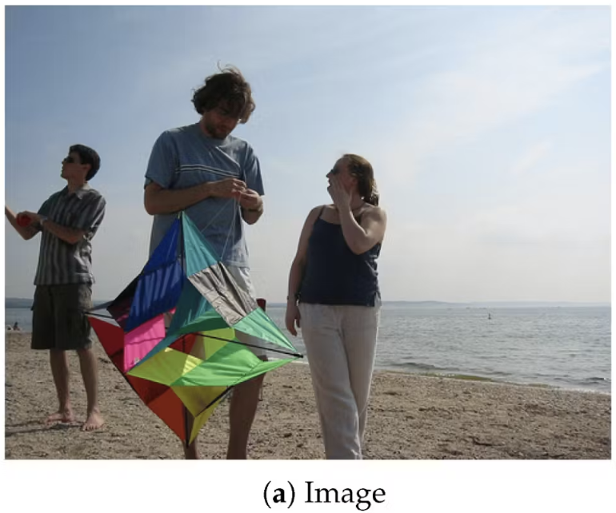
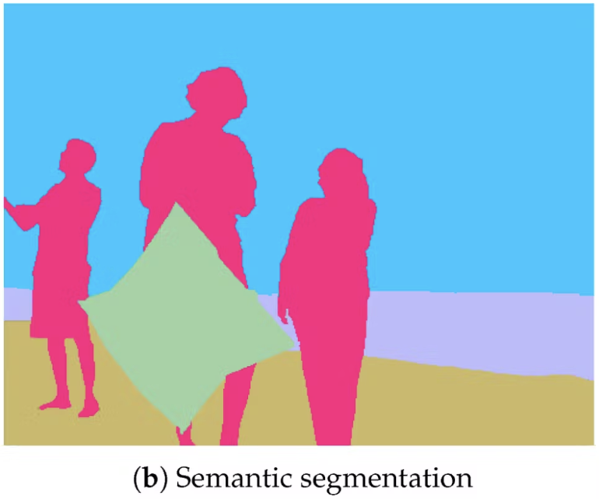
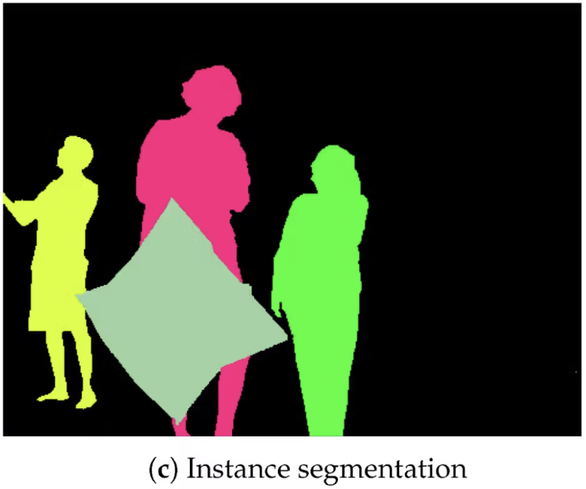
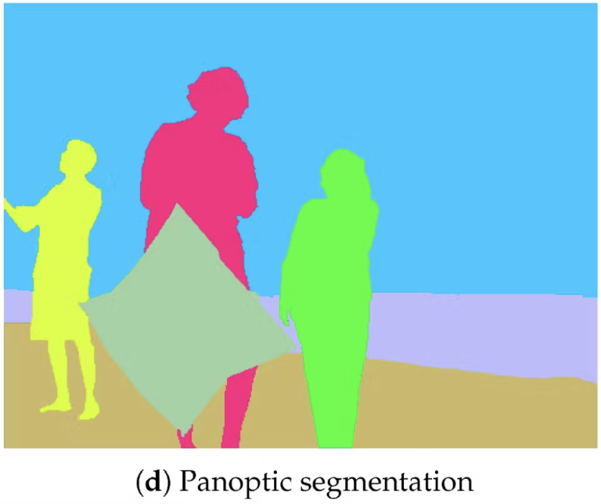
What is Segmentation?

Slide 4
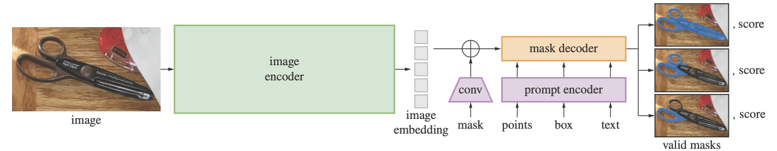
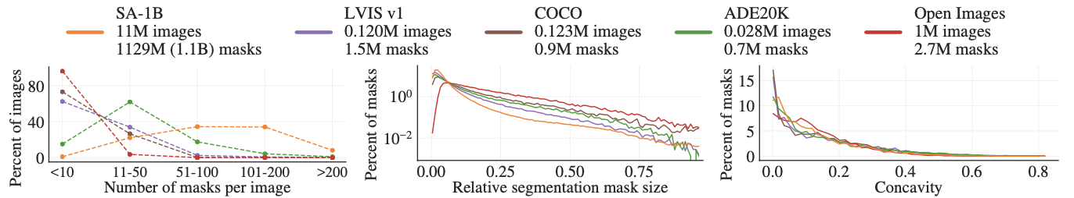
SAM (Segment Anything Model)
SAM Overview
SA-1B Dataset SA-1B has 11X more images and 400X more masks than the largest existing segmentation dataset Open Images

Slide 5
Motivation
Existing Models:
SAM:
Sets new benchmark with its zero-shot segmentation ability, achieving an AP of 46.5 on COCO dataset.
Uses a prompt-based ViT-H encoder, trained on SA-1B dataset with more than 1B masks from 11M images.
High Computational Cost: Employs a Vision Transformer (ViT-H) with 632 million parameters.
Difficult deployment in resource-constrained environments and it is infeasible for real-time applications due to its high computational demands.
FastSAM:
Improves efficiency (approx. 50 times faster than SAM) of SAM with a CNN architecture.
Achieves an AP of 37.9 on COCO, a decrease from SAM's performance.
MobileSAM:
Introduces a lightweight model (approx. 9.66 million parameters) via decoupled distillation.
Achieves an AP of 38.7 on COCO, a decrease from SAM's performance.

Slide 6
Problem Statement
How can we design a segmentation model that maintains the high accuracy and versatility of SAM while significantly reducing its computational cost and model size?
Is it possible to achieve a balance where the model is both highly efficient for deployment on constrained devices and maintains competitive performance metrics for complex segmentation tasks?

Slide 7
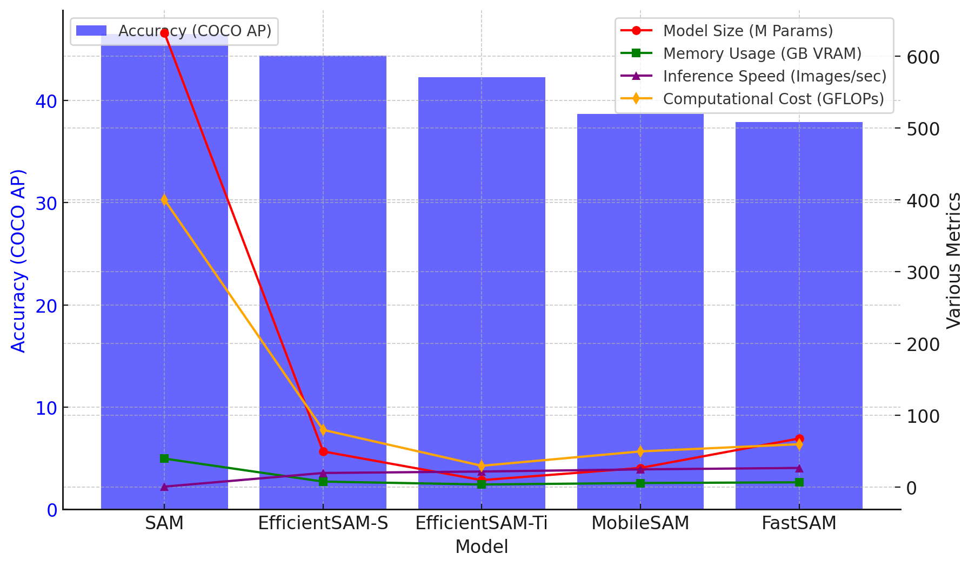
EfficientSAM
There are 2 versions of EfficientSAM:
EfficientSAM-Ti:
Parameters: Reduced to 9.8 million.
AP on COCO: Achieves 42.3
Inference Time: Approximately 20x faster than SAM.
EfficientSAM-S:
Parameters: Approximately 20x less than SAM
AP on COCO: Achieves 44.4
Inference Time: Approximately 20x faster than SAM.
SAMI (SAM-leveraged Masked Image Pretraining) enables efficient learning and creates lightweight models for practical deployment.

Slide 8

Challenges
Managing Computational Cost
Data and Benchmarking Limitations
Reducing computational cost without sacrificing performance.
Ensuring consistency in performance metrics across different datasets and hardware setups.
Deploying Lightweight Encoders
Balancing Accuracy and Efficiency
Develop small yet efficient models for zero-shot segmentation.
Achieving the right trade-off between model accuracy and efficiency.
Model Scalability
Generalization Across Models
Ensuring that the optimized models scale well with increasing dataset sizes and real-world applications, without compromising on performance or efficiency.
Ensure models perform well across multiple vision tasks.

Slide 9


Related Work with Limitations
Model | Work | Limitations | Related Research Papers
SAM (Segment Anything Model) | Segment Anything Model, capable of segmenting any object using interaction prompts. | High computational cost & large model size limits real-world deployment. | "Segment Anything Model" (2023)
Vision Transformers (ViTs) | Significant improvements in accuracy in various vision applications. | High computational and memory demands, making them less efficient for large images and real-time processing. | Dosovitskiy et al., "An image is worth 16x16 words: Transformers for image recognition at scale" (2020), MobileViT (2021), EfficientViT (2023)

Slide 10
Related Work with Limitations
Model | Work | Limitations | Related Research Papers
Knowledge Distillation | Distills knowledge from a larger teacher model to a smaller student model. | Distillation may not fully retain the teacher model's performance in all tasks. | Hinton et al., "Distilling the knowledge in a neural network" (2015), Romero et al., "FitNets: Hints for thin deep nets" (2014), Wu et al., "Self-supervised teaching assistant" (2022)
Masked Image Modeling (MIM) | Pretraining method that reconstructs masked image patches for representation learning. | Relies on high-capacity teacher models, adding significant pretraining overhead. | Bao et al., "BEiT: BERT pre-training of image transformers" (2021), Xie et al., "SimMIM: A simple framework for masked image modeling" (2022), He et al., "Masked autoencoders are scalable vision learners" (2022)

Slide 11
Datasets
Dataset | Purpose | Details | Use in Research
ImageNet-1K | Image classification | 1.2M training images, 50K validation images across 1,000 different classes | SAMI pretraining for lightweight ViT encoders.
SA-1B Segment Anything 1 Billion | Segment Anything task | 1B masks from 11M high-resolution images | Fine-tuning EfficientSAM for segmenting any object in an image.
ADE20K | Semantic segmentation | 20K training, 2K validation, 3K test images | Testing generalization of SAMI-pretrained models in semantic segmentation.
COCO Common Objects in Context | Object detection & instance segmentation | 118K training images, 5K validation images | Evaluating EfficientSAM's performance for detection and segmentation tasks.
LVIS Large Vocabulary Instance Segmentation | Instance Segmentation | Features precise instance segmentation masks for objects across 1,203 categories | Evaluating EfficientSAM's performance IN zero-shot and point-based instance segmentation.

Slide 12
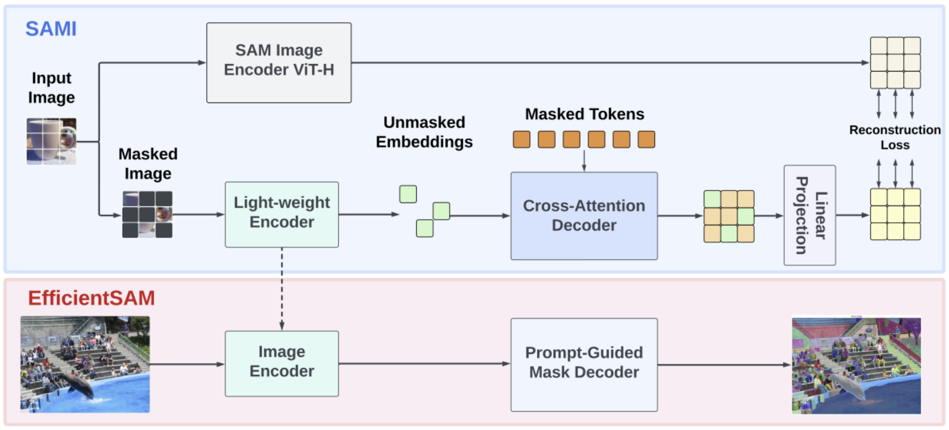
Methodology: SAMI Pretraining
Step 1: Input Image Processing
Input image is passed through the SAM Image Encoder (ViT-H).
The SAM Image Encoder extracts rich feature embeddings from the image.
A masked version of the image is also created, where parts of the image are hidden to train the model to reconstruct them.
The EfficientSAM framework consists of two key stages:
SAMI Pretraining (Top Blue Section)
EfficientSAM Fine-Tuning (Bottom Red Section)

Slide 13
Methodology: SAMI Pretraining
Step 2: Masked Autoencoder (MAE) Approach
The masked image is processed by a Lightweight Encoder.
The encoder extracts features from the visible (unmasked) tokens, while masked parts remain hidden.
The output consists of unmasked embeddings (green blocks).
The EfficientSAM framework consists of two key stages:
SAMI Pretraining (Top Blue Section)
EfficientSAM Fine-Tuning (Bottom Red Section)

Slide 14
Methodology: SAMI Pretraining
Step 3: Cross-Attention Decoder
The Cross-Attention Decoder takes both:
Unmasked embeddings from the encoder.
Masked tokens (orange blocks) that need reconstruction.
The decoder predicts missing details in the masked tokens using the context provided by the unmasked parts.
The EfficientSAM framework consists of two key stages:
SAMI Pretraining (Top Blue Section)
EfficientSAM Fine-Tuning (Bottom Red Section)

Slide 15
Methodology: SAMI Pretraining
Step 4: Linear Projection & Reconstruction Loss
Reconstructed features pass through a Linear Projection Head to align with SAM Image Encoder features.
Reconstruction Loss is computed by comparing original SAM features with reconstructed masked tokens.
The model minimizes loss to ensure the lightweight encoder learns accurate representations.
The EfficientSAM framework consists of two key stages:
SAMI Pretraining (Top Blue Section)
EfficientSAM Fine-Tuning (Bottom Red Section)

Slide 16
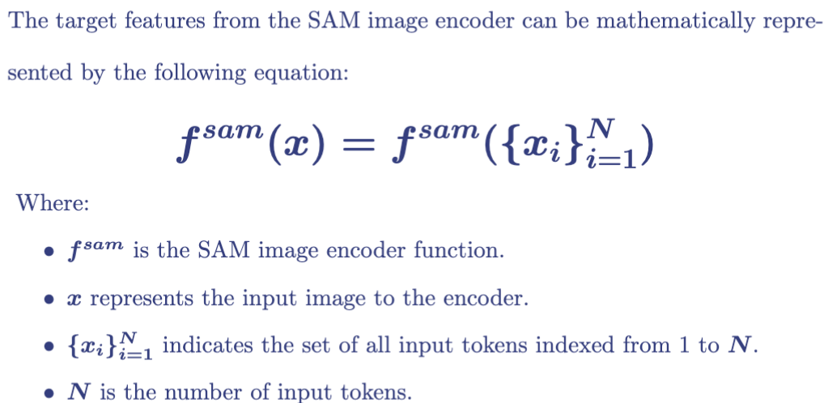
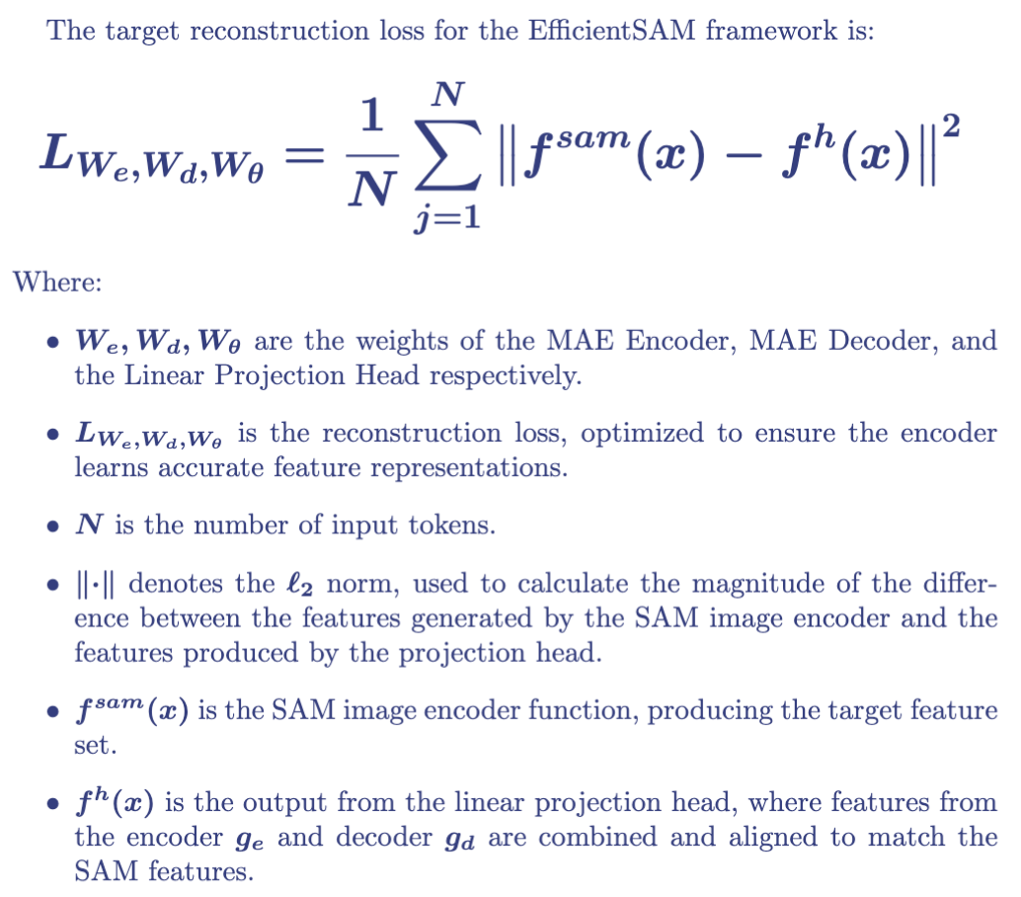
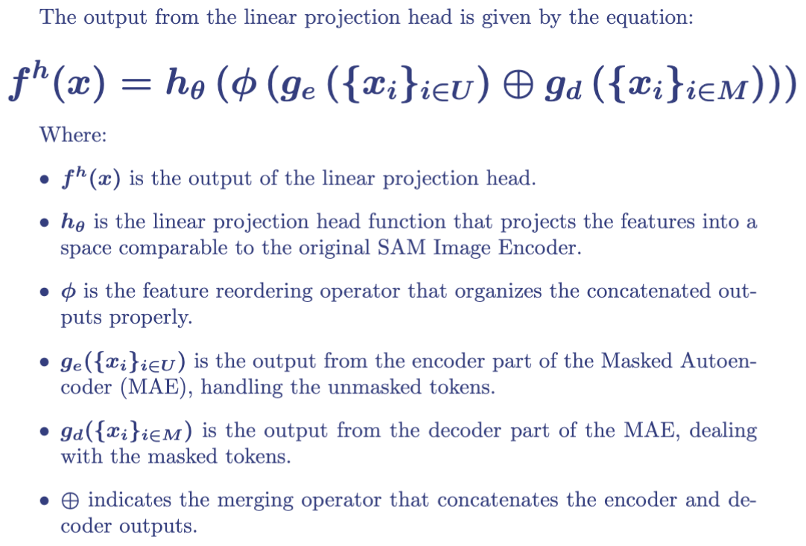
Methodology: Reconstruction Loss

Slide 17
Methodology: EfficientSAM Fine-Tuning
Step 5: Using Pretrained Lightweight Encoder
After SAMI pretraining is complete, the Cross-Attention Decoder is discarded.
The Lightweight Encoder is retained and used as the Image Encoder for EfficientSAM.
This encoder now has learned representations from SAM but is much smaller and efficient.
The EfficientSAM framework consists of two key stages:
SAMI Pretraining (Top Blue Section)
EfficientSAM Fine-Tuning (Bottom Red Section)

Slide 18
Methodology: EfficientSAM Fine-Tuning
Step 6: Fine-Tuning on SA-1B
The pretrained Lightweight Encoder is now fine-tuned on SA-1B (Segment Anything Dataset).
The Prompt-Guided Mask Decoder is used to generate segmentation masks based on user prompts.
The EfficientSAM framework consists of two key stages:
SAMI Pretraining (Top Blue Section)
EfficientSAM Fine-Tuning (Bottom Red Section)

Slide 19
Methodology: EfficientSAM Fine-Tuning
Step 7: EfficientSAM Generates Final Segmentation Masks
When given a new input image, EfficientSAM processes it through the Image Encoder and Prompt-Guided Mask Decoder.
The output is an accurate segmentation mask, similar to SAM but generated much faster and with lower computational cost.
The EfficientSAM framework consists of two key stages:
SAMI Pretraining (Top Blue Section)
EfficientSAM Fine-Tuning (Bottom Red Section)

Slide 20
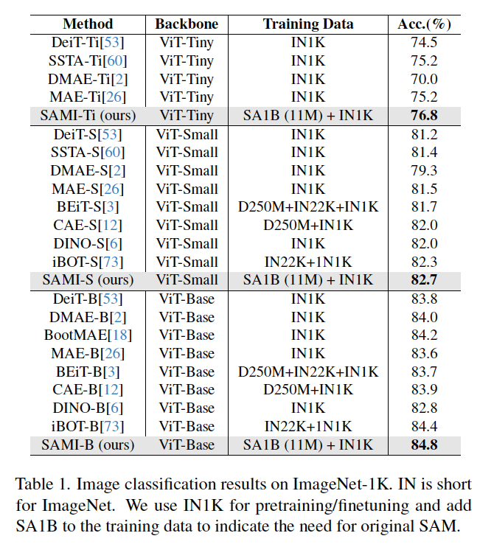
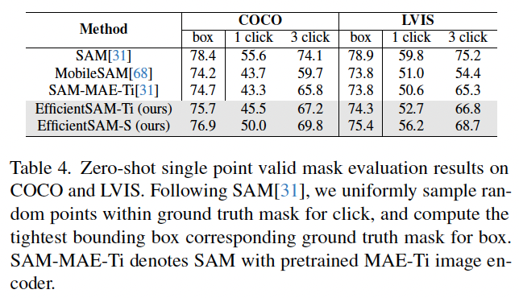
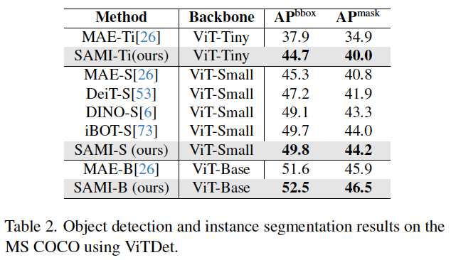
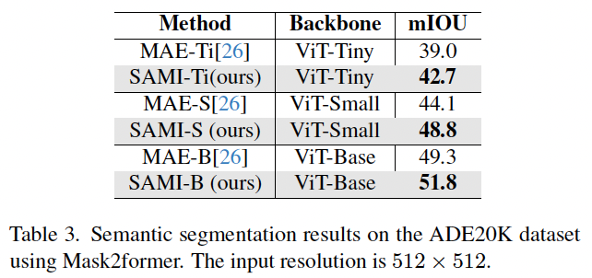
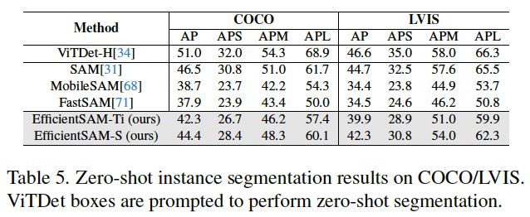
Experiments & Results
Object Detection and Instance Segmentation
Zero-Shot Single Point Valid Mask Evaluation
Image Classification
Semantic Segmentation
Zero-Shot Instance Segmentation

Slide 21
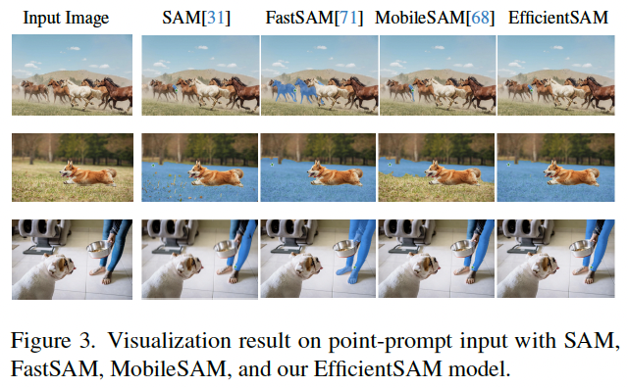
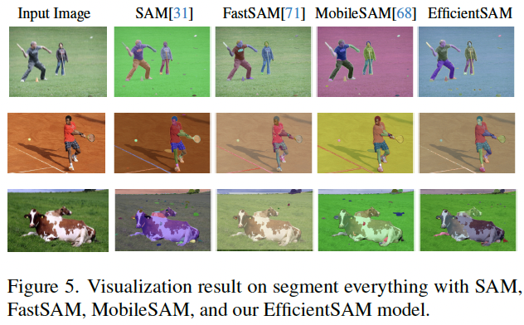
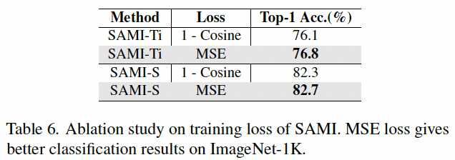
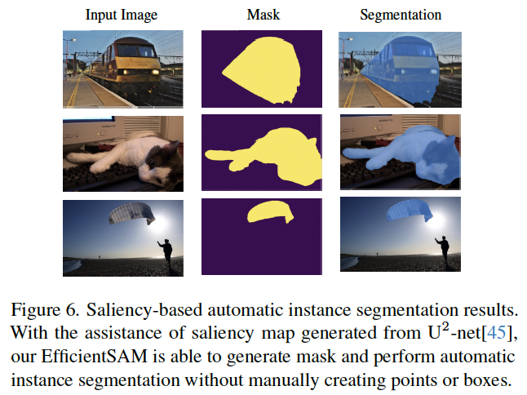
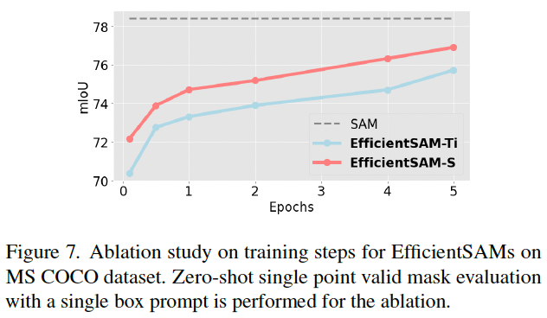
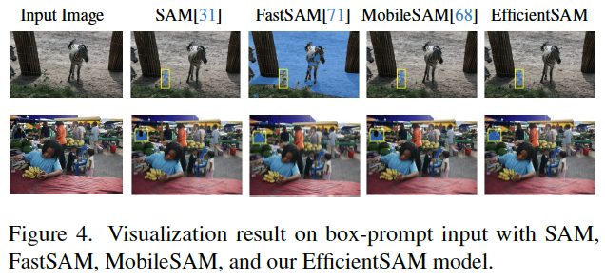
Experiments & Results
Point-Prompt Segmentation
Segment Everything Task
Ablation Study on Training Loss of SAMI
Ablation Study on Training Steps of EfficientSAM on COCO dataset
Salient Instance Segmentation
Box-Prompt Segmentation

Slide 22
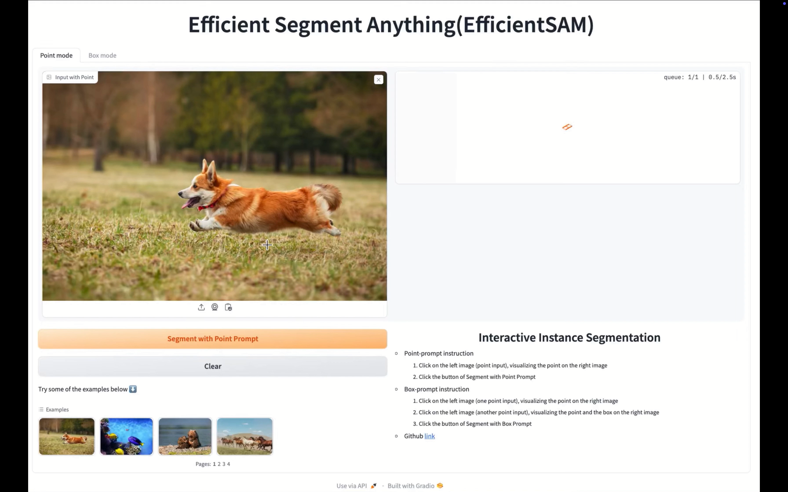
Live Demo:
Point-Prompt Segmentation
Box-Prompt Segmentation
https://huggingface.co/spaces/yunyangx/EfficientSAM

Slide 23
Limitations of the Proposed Method
Trade-off Between Efficiency and Accuracy:
1. EfficientSAM:
Goal: Reduce computational overhead of the original SAM model.
Approach: Implement a lighter, more efficient model architecture.
Model Changes: Uses smaller networks, fewer parameters, simplified layers.
Reason: Original SAM known for high accuracy, but with high computational demands.
2. Consequence:
Efficiency vs. Accuracy: Simplification leads to reduced accuracy.
Detail Limitation: Lightweight models may not capture complex details as effectively as SAM.
Deployment: Works well on low-power devices but may struggle with complex tasks.
Learning Impact: Limits ability to generalize across large, diverse datasets.
Example: In critical applications like medical imaging or complex scene segmentation, reduced model complexity may result in less precise outcomes.

Slide 24
Future Work
1. Quantization & Pruning
Quantization: Implement techniques to reduce model size and accelerate inference by lowering numerical precision without a substantial loss in accuracy.
Pruning: Remove non-essential neurons to decrease complexity and enhance operational speed, maintaining performance integrity.
2. Hybrid Encoder Architecture
Combination: Utilize a mix of CNNs and ViTs to leverage local feature extraction and global contextual understanding.
Goal: Achieve a balanced model that offers both efficiency and robust handling of complex tasks.
3. Dynamic Resolution Adaptation
Adaptive Input: Adjust image resolution based on task complexity to optimize computational resources.
Efficiency: Lower resolution for simpler tasks, higher for complex scenarios to maintain accuracy without excess computation.

Slide 25
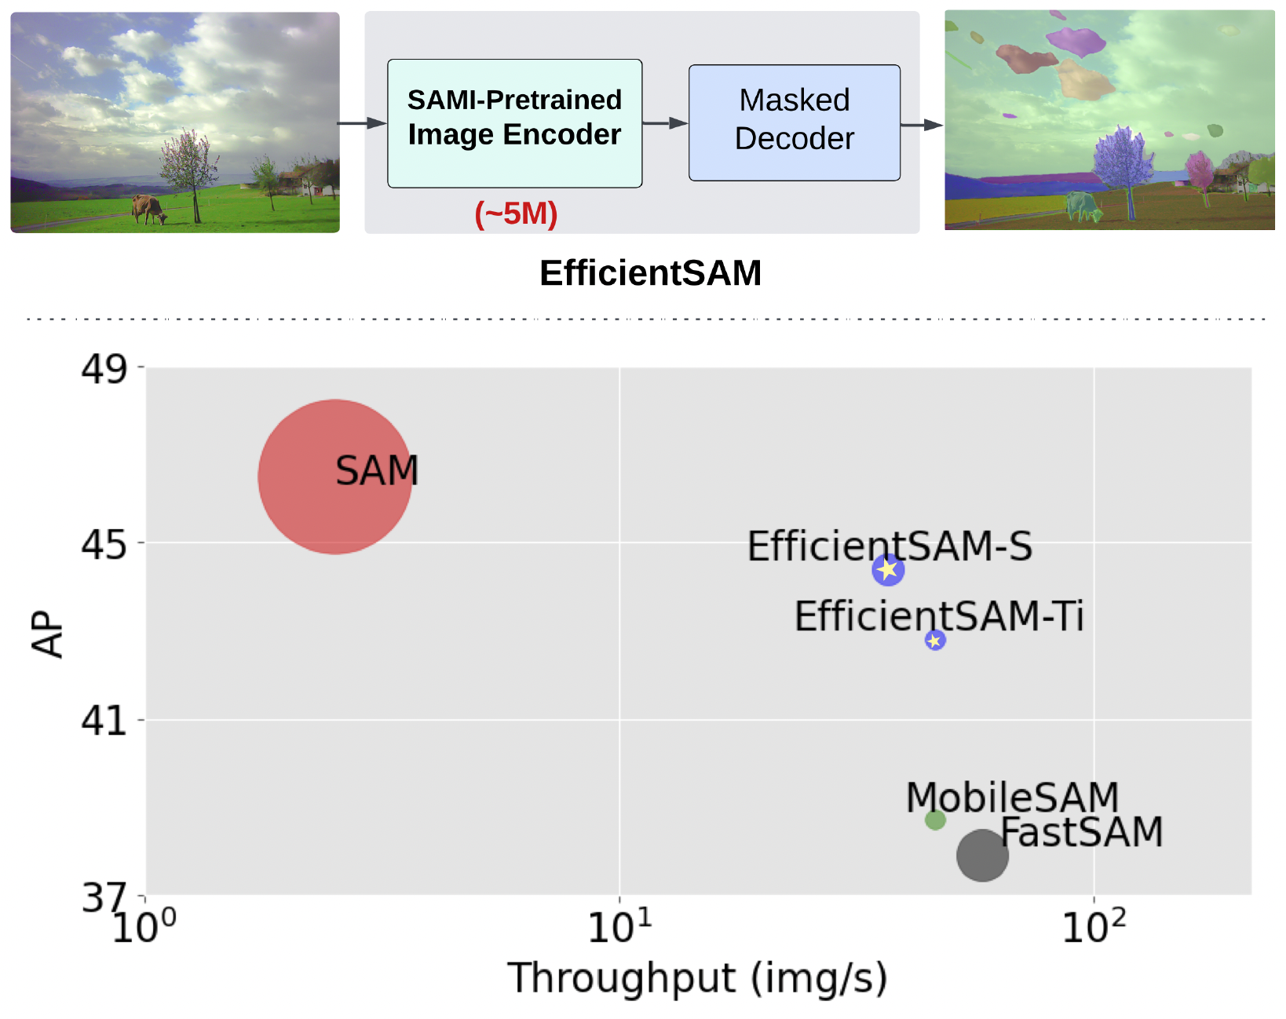
Conclusion
SAMI (SAM-leveraged Masked Image Pretraining) enhances ViTs by leveraging the SAM foundation model.
Improves pretraining by reconstructing latent features from SAM’s image encoder.
Proven effective across tasks: image classification, object detection, instance segmentation, semantic segmentation, and segment anything.
EfficientSAM-S reduces the inference time of SAM by ∼20x and the parameter size by ∼20x with a small performance drop, 44.4 AP vs 46.5 AP.
Performance for Zero-Shot Instance Segmentation on COCO dataset.

Slide 26
References
SAM (Segment Anything Model) – Kirillov et al., "Segment Anything Model," 2023.
Masked Autoencoders (MAE) – He et al., "Masked Autoencoders Are Scalable Vision Learners," 2022.
Vision Transformers (ViTs) – Dosovitskiy et al., "An Image is Worth 16x16 Words: Transformers for Image Recognition at Scale," 2020.
Knowledge Distillation – Hinton et al., "Distilling the Knowledge in a Neural Network," 2015.
Self-Supervised Pretraining (BEiT, iBOT, DINO, CAE, etc.) – Bao et al., "BEiT: BERT Pre-Training of Image Transformers," 2021.
FastSAM & MobileSAM – Yang et al., "Fast Segment Anything," 2023; Li et al., "MobileSAM: Lightweight Segment Anything Model," 2023.
Mask2Former (Semantic Segmentation) – Cheng et al., "Mask2Former: Masked-Attention Transformer for Universal Image Segmentation," 2021.
ViTDet (Object Detection with Vision Transformers) – Li et al., "Exploring Plain Vision Transformer Backbones for Object Detection," 2022.
U²-Net (Saliency-based Segmentation) – Qin et al., "U²-Net: Going Deeper with Nested U-Structure for Salient Object Detection," 2020.

Slide 27

Thank You

